Slide 1

Instacart Classification
Model
Patrick Lee • 02.13.2019

Slide 2
Mission:
-Help Instacart determine whether a customer will repurchase a product
-Target advertising, recommend products (frequently bought with), easy add-to-cart strategies (click to order/buy again/subscriptions), inventory
-Using F1 score. Balance recommending the right products, but not too costly if we recommend the wrong products.

Slide 3
Methodology
Subset
Initially 34 million+ rows
Created a subset of 10% of user base

Slide 4
Methodology
Subset
Modeling
Initially 34 million+ rows
Created a subset of 10% of user base
Tuned my model using the subset
Broke down my subset into a train and validation set using a 80/20 split
Scored using F1

Slide 5
Methodology
Subset
Modeling
Holdout
Initially 34 million+ rows
Created a subset of 10% of user base
Tuned my model using the subset
Broke down my subset into a train and validation set using a 80/20 split
Scored using F1
Tested model on full data
Trained on 80%
Scored on 20%
AWS

Slide 6
Subset Modeling

Slide 7
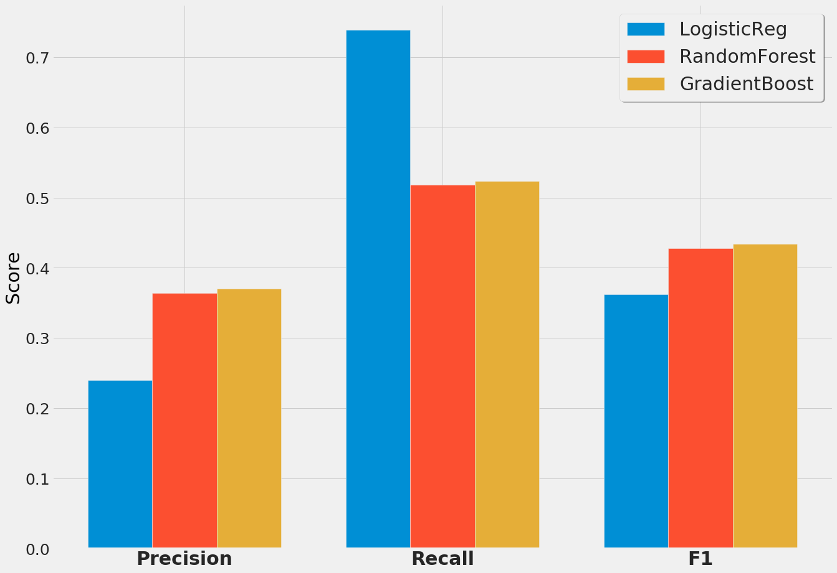
Model
Selection

Slide 8
Model
Selection

Slide 9
Model
Selection

Slide 10
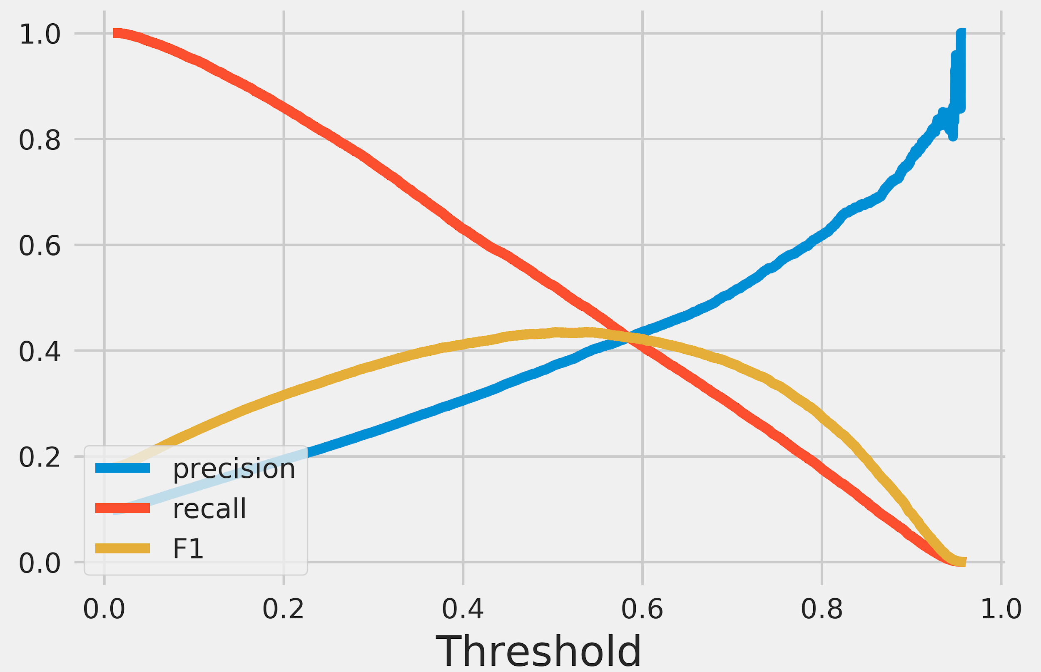
F1 curves (Gradient Boosted model)

Slide 11
A deeper look at the features:

Slide 12
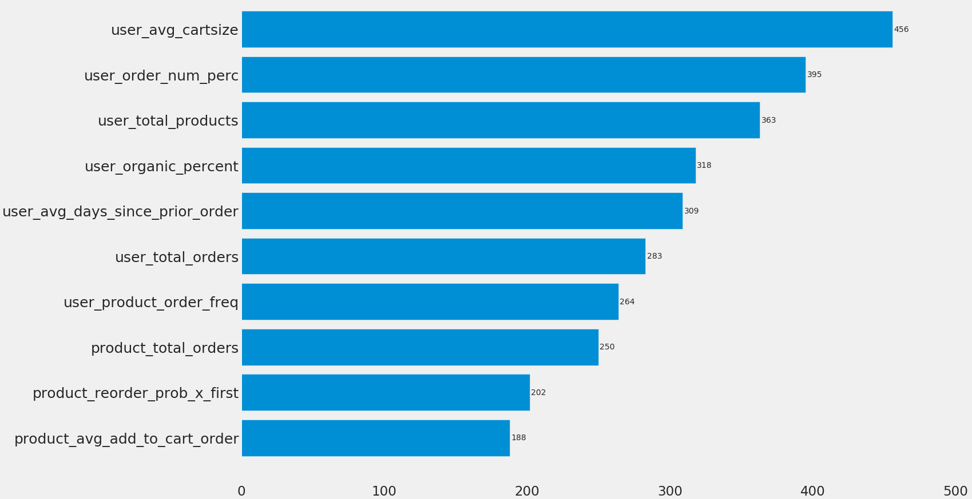
Top 10 Features

Slide 13
Top 10 Features

Slide 14
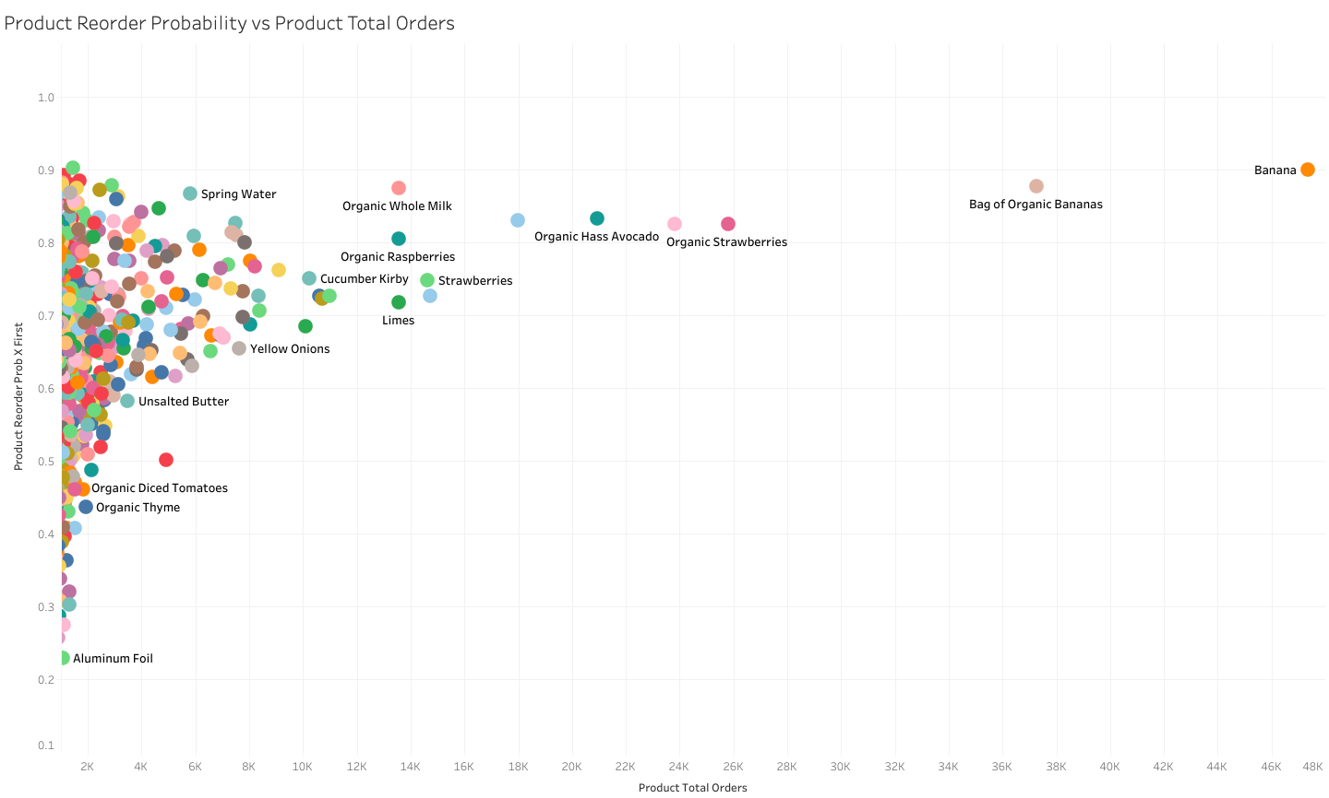

Slide 16
ALL ORGANIC!!!

Slide 17
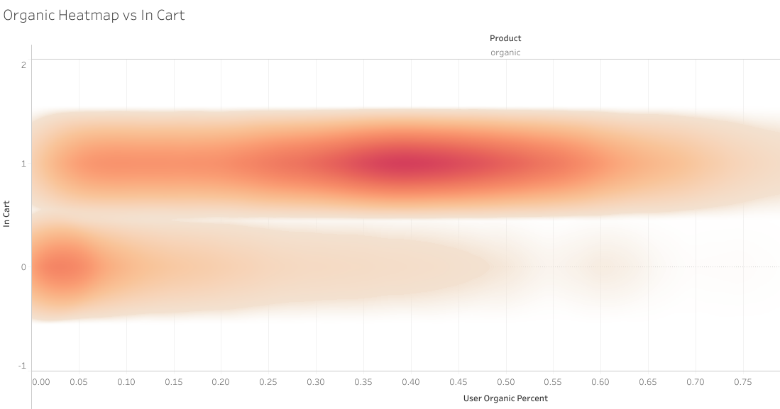

Slide 18
Results in holdout
Subset Full Data
Recall
.53 .53
Precision
.37 .38
F1 Score
.43 .45

Slide 19
Results in holdout
Subset Full Data
Recall
.53 .53
Precision
.37 .38
F1 Score
.43 .45

Slide 20
Thank you!

Slide 21
Appendix

Slide 22
